Slide 1
SmartCart Customer Segmentation
1 · BUSINESS PROBLEM
From one-size-fits-all marketing to data-driven personas
Business problem
ML translation
Outcome
Wasted marketing budget
VIP churn
Low conversion
Unsupervised clustering
2,240 customers, 22 attributes
4 customer personas
Strategy, KPIs, A/B plan
SmartCart Customer Segmentation | 1 / 7

Slide 2
Understanding the data with Python statistics
2 · DATA UNDERSTANDING
$666,666
24
5.79 | 4.08 | 2.66
14.9%
max income (median $51,382)
missing incomes (1.07%)
campaign response rate
store | web | catalog purchases
Skewed income
→
Median imputation, outlier flag
Six spend columns
→
One Total_spending feature
Mixed scales
→
StandardScaler
Python · pandas · scikit-learn
SmartCart Customer Segmentation | 2 / 7

Slide 3
Feature engineering in Python
3 · CLEANING & FEATURE ENGINEERING
Age
22 → 15
2026 − Year_Birth
features
Tenure days
24 nulls: median imputation
Education 5 → 3, marital 8 → 2
12 columns dropped
Latest Dt_Customer − own Dt_Customer
Total_spending
Sum of 6 product-spend columns
Total_childrens
Kidhome + Teenhome
SmartCart Customer Segmentation | 3 / 7

Slide 4
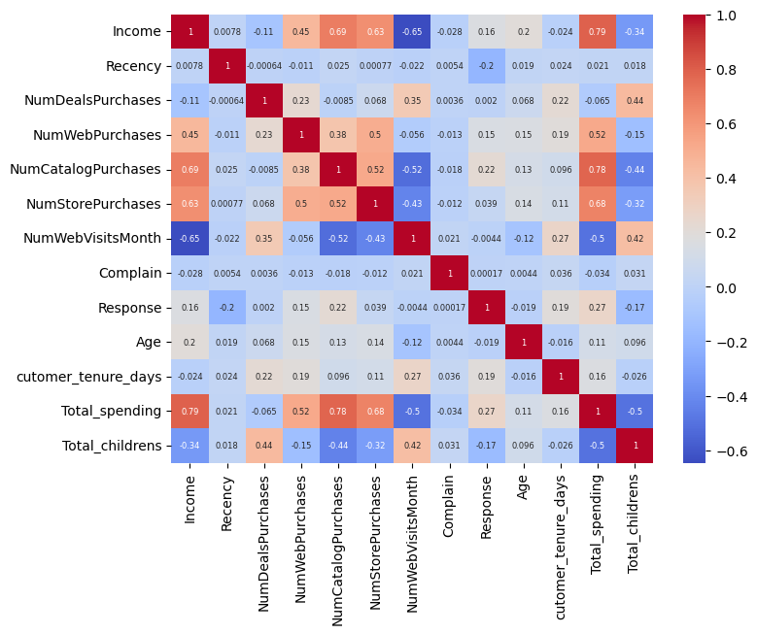
EDA finds the features that matter
4 · EDA, ENCODING & PCA
Outliers
Removed income > $600k and age > 90
Heatmap
Income ↔ spend r ≈ 0.79; children ↔ spend r ≈ −0.50
Encode, scale, PCA
One-hot + StandardScaler; PCA 18D → 2D / 3D
Why it matters
Stable model inputs, drivers marketing can explain
SmartCart Customer Segmentation | 4 / 7

Slide 5
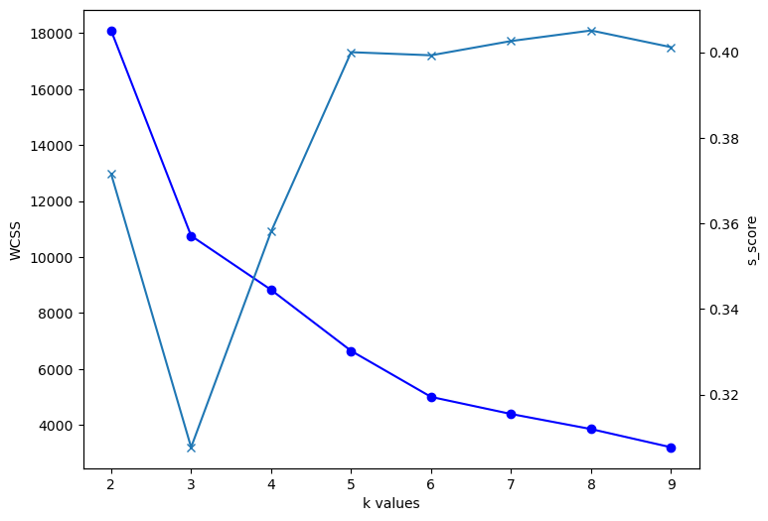
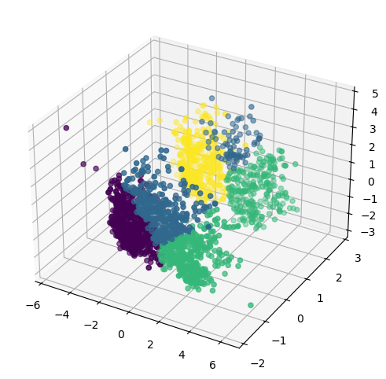
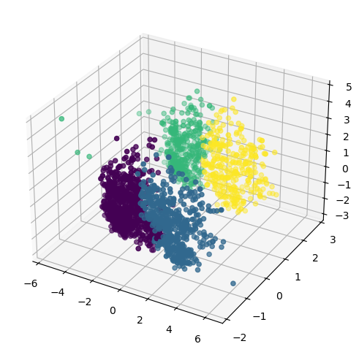
Model Selection: Unsupervised ML Algorithms
5 · K-VALUE & ALGORITHM CHOICE
Elbow (WCSS) + Silhouette
K-Means (K=4)
Agglomerative (final)
Elbow bends at K = 4; silhouette ≈ 0.36 at K = 4
Fast centroid baseline; assumes spherical clusters
Ward hierarchy: tighter, better-separated clusters
SmartCart Customer Segmentation | 5 / 7

Slide 6
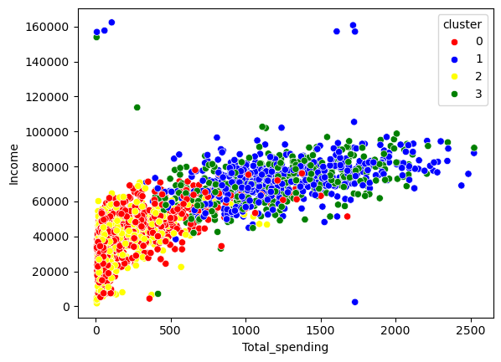
Four personas, four strategies
6 · CLUSTER SUMMARY
Income vs total spending, by cluster
Cluster 0
Cluster 1
Family Shoppers
Premium Couples
Browse a lot, buy little
High spend, all channels
Convert with bundles
Protect with loyalty perks
Cluster 2
Cluster 3
Digital Browsers
Premium Singles
Low income, many visits
Top spend, best response
Convert with flash sales
High-touch, high-ROI offers
SmartCart Customer Segmentation | 6 / 7

Slide 7
Targeted actions, then rollout
7 · RECOMMENDATIONS & DEPLOYMENT
Family Shoppers
Coupons and family bundles
Conversion, AOV
Premium Couples
VIP loyalty and early access
Retention, LTV
Digital Browsers
Flash sales, cart-abandonment offers
Visits to purchases
Premium Singles
1-on-1 offers, concierge
Campaign ROI
Step 1
Step 2
Step 3
Step 4
Pipeline
CRM
A/B test
Monitor
Assign new customers to clusters in the warehouse
Push labels to Klaviyo or Salesforce
Targeted vs generic; track lift, LTV, CAC
Re-cluster quarterly
SmartCart Customer Segmentation | 7 / 7

